Slide 1
Biki Nath Newa
Hein Min Htet
Predicting Uber Ride Cancellations via Machine Learning

Slide 2
Presentation
overview
Project Recap
Final Model Performance Results
Comparison With Other’s Work
Discussion
Conclusion

Slide 3
Project Recap

Slide 4
Possible Impact
Reduced Platform Trust
Inefficient Driver Allocation
Hidden Costs
Overall Risk
Users may switch to competitors.
Drivers waste time and fuel on cancelled rides.
Extra burden on servers, computing, and energy.
Weakens long-term customer loyalty and business growth.
Business View :
Cancellations not only affect revenue but also raise operational costs, lower platform credibility, and increase customer churn.

Slide 5
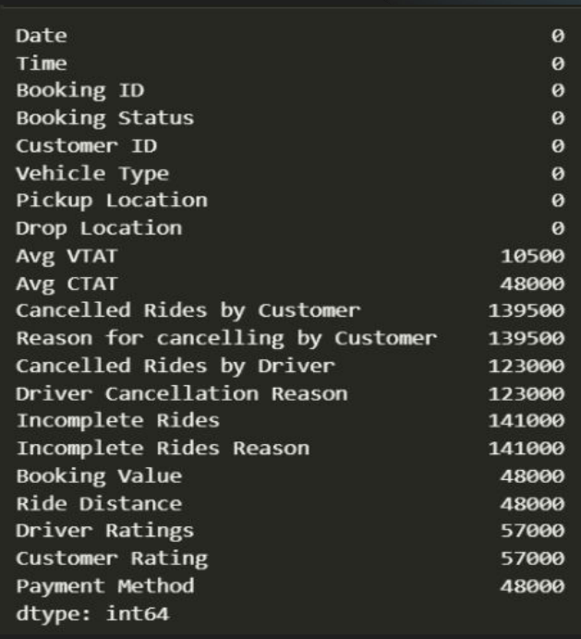
Dataset of Uber Ride Analytics Dashboard
Features
The dataset contains the following features:
• Date and Time of Booking
• Booking ID, Customer ID
• Booking Status (Completed, Incomplete, Cancelled By Driver, Cancelled by Customer)
• Vehicle Type
• Pickup and Drop location
• Average Time to Customer
• Average Time from Pickup to Destination
• Cancelled By Customer, Customer Cancellation

Slide 6
EDA- Exploratory Data Analysis
Pre-processing
Modelling
Training
Evaluation
Modelling
The final, trained model deployed as a simple web application using Dash. The steps are as follows: 1. Save the trained scikit-learn model as a pickle file. 2. Create a Dash web app that loads the model. 3. Build a simple HTML interface where a user can input ride details (e.g., pickup point, time) and receive a cancellation prediction.
After exploring what our data set looks like, we need to do preprocessing. The most pressing concerns are how we should handle the high amount of NaN, due to poor one hot encoding as well as the lack of a balanced dataset.
Since this is a classification problem, we experiment with several models starting with Random Forest but we will probably need to settle for a more advanced model.
Training will be done by the scikit-learn .fit method. We trained the best model with best hyper-parameters with all training set, unlike in cross-validation that some parts of training set were separated to validation set.
• Precision = TP / (TP + FP) • Recall = TP / (TP + FN) • F1-Score = 2 * [( Precision * Recall) / (Precision + Recall)] • R-Squared (R²) = 1 - (Sum of Squared Residuals / Total Sum of Squares)

Slide 7
How it works
Model Families Trained
We primarily worked on two machine learning model families, Random Forest and XGBoost. They are the industry standard for tabular data of sizes where we exceed a few hundred rows. Similarly Gradient Boosting Machines like XGBoost are the undisputed state of the art for these types of problems and often outperform Neural Networks (Deep Learning) on this type of structured data.

Slide 8
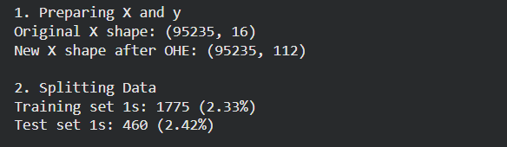
Trained Model - Classification Report
Model 1: Unstratified Random Forest Without SMOTE
 | precision | recall | f1-score | support
0 | 0.98 | 1.00 | 0.99 | 18587
1 | 0.99 | 0.30 | 0.47 | 460
accuracy |  |  | 0.98 | 19047
macro avg | 0.99 | 0.65 | 0.74 | 19047
weighted avg | 0.98 | 0.98 | 0.98 | 19047

Slide 9
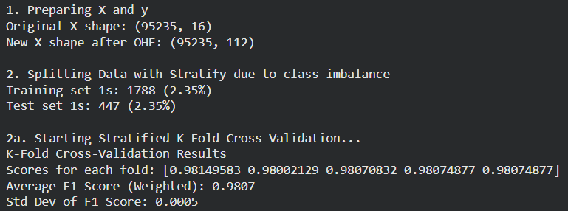
Trained Model - Classification Report
Model 2: Stratified K-Fold Random Forest Without SMOTE
 | precision | recall | f1-score | support
0 | 0.98 | 1.00 | 0.99 | 18600
1 | 1.00 | 0.32 | 0.48 | 447
accuracy |  |  | 0.98 | 19047
macro avg | 0.99 | 0.66 | 0.74 | 19047
weighted avg | 0.98 | 0.98 | 0.98 | 19047

Slide 10
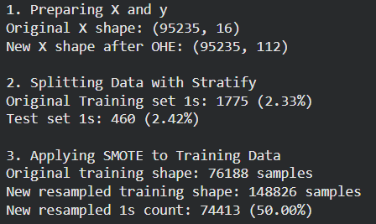
Trained Model - Classification Report
Model 3: Unstratified Random Forest With SMOTE
 | precision | recall | f1-score | support
0 | 0.98 | 1.00 | 0.99 | 18587
1 | 0.99 | 0.31 | 0.47 | 460
accuracy |  |  | 0.98 | 19047
macro avg | 0.98 | 0.65 | 0.73 | 19047
weighted avg | 0.98 | 0.98 | 0.98 | 19047

Slide 11
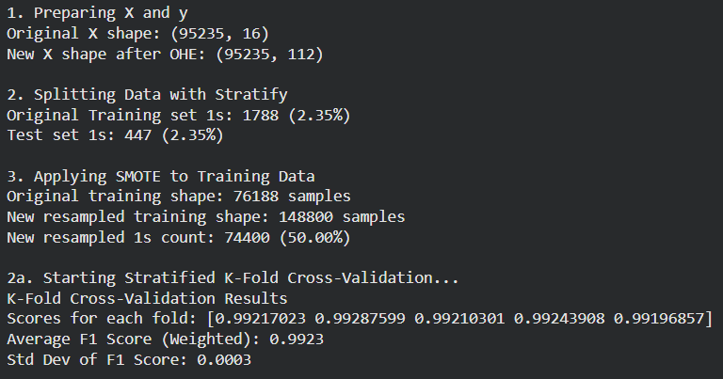
Trained Model - Classification Report
Model 4: Stratified K-Fold Random Forest With SMOTE
 | precision | recall | f1-score | support
0 | 0.98 | 1.00 | 0.99 | 18600
1 | 1.00 | 0.32 | 0.48 | 447
accuracy |  |  | 0.98 | 19047
macro avg | 0.99 | 0.66 | 0.74 | 19047
weighted avg | 0.98 | 0.98 | 0.98 | 19047

Slide 12
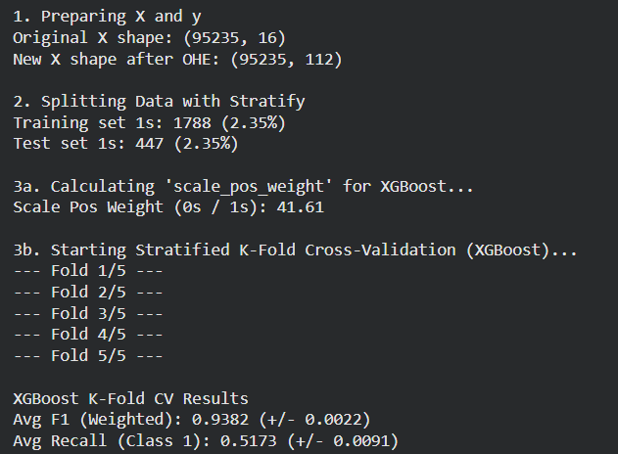
Trained Model - Classification Report
Model 5: Stratified K-Fold XGBoost
 | precision | recall | f1-score | support
0 | 0.98 | 0.99 | 0.99 | 18600
1 | 0.47 | 0.34 | 0.39 | 447
accuracy |  |  | 0.98 | 19047
macro avg | 0.73 | 0.66 | 0.69 | 19047
weighted avg | 0.97 | 0.98 | 0.97 | 19047

Slide 13
Trained Model - Classification Report
Selected Model: Stratified Random Forest
Metric | Class 0 (Not Cancelled) | Class 1 (Cancelled) | Overall Accuracy | Macro Avg | Weighted Avg
Precision | 0.98 | 1.00 |  | 0.99 | 0.98
Recall | 1.00 | 0.32 |  | 0.66 | 0.98
F1-score | 0.99 | 0.48 | 0.98 | 0.74 | 0.98
Support | 18,600 | 447 | 19,047 | 19,047 | 19,047

Slide 14
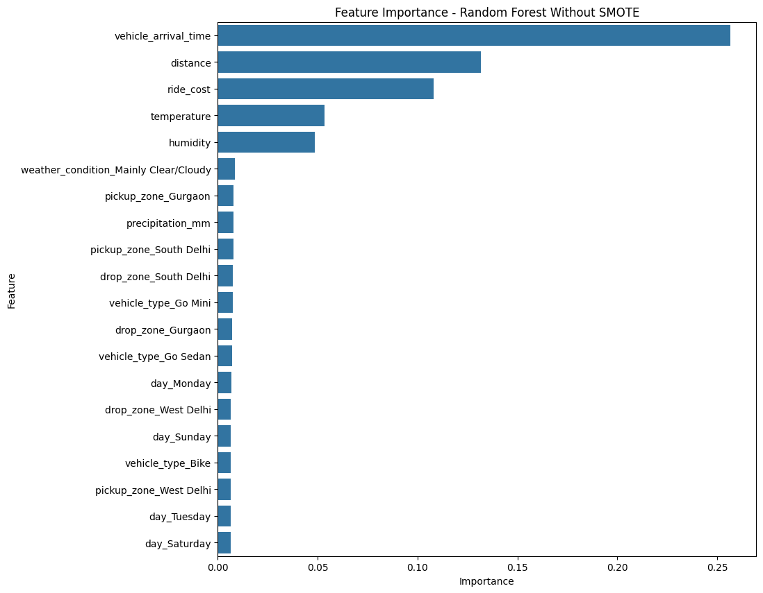
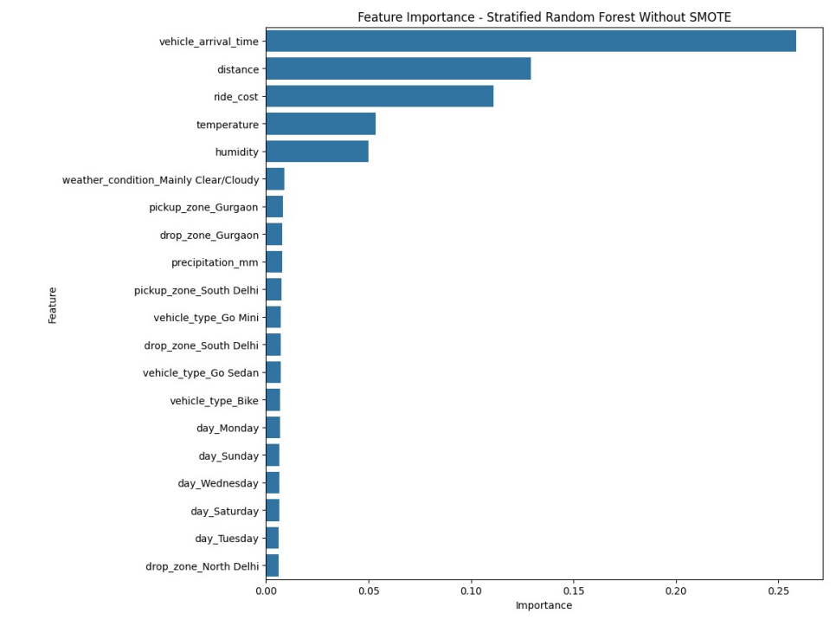
Feature Importance
Model 1 - Random Forest Without SMOTE
Model 2 - Stratified K-Fold Random Forest Without SMOTE

Slide 15
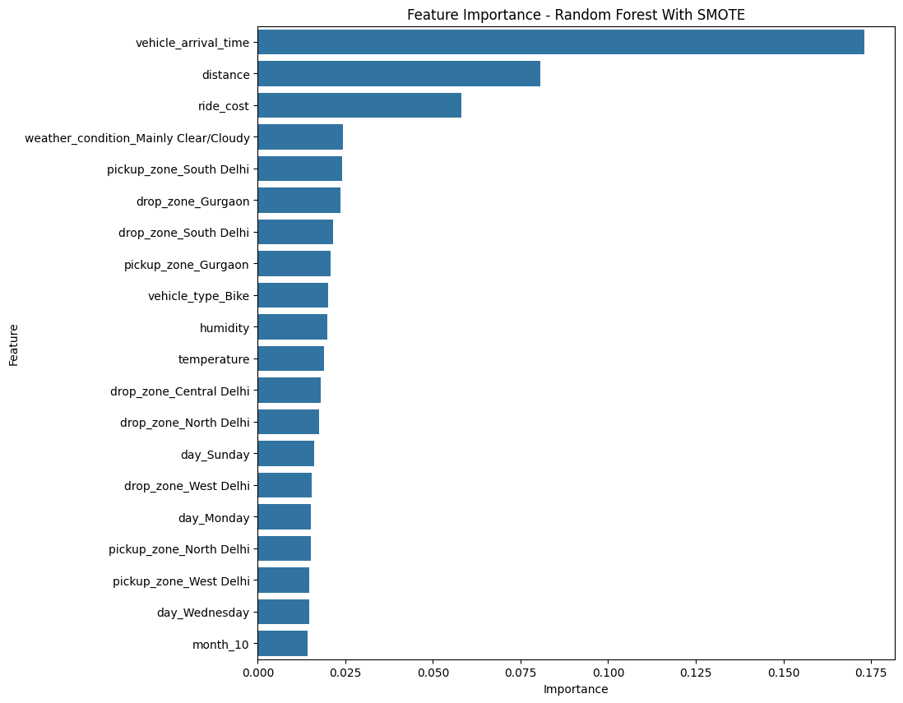
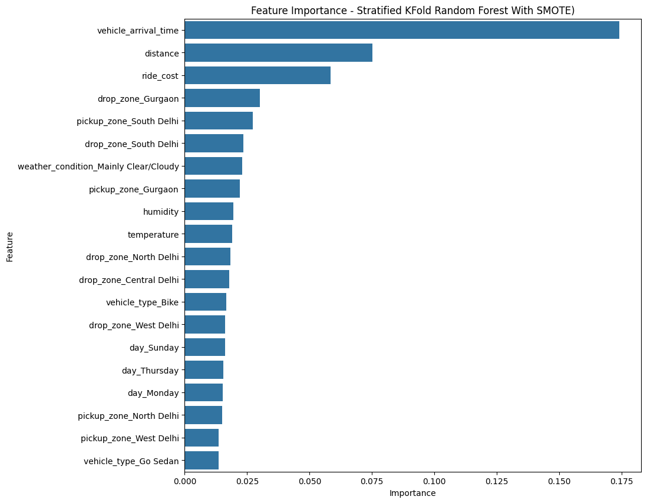
Feature Importance
Model 3 - Unstratified Random Forest With SMOTE
Model 4- Stratified K-Fold Random Forest With SMOTE

Slide 16
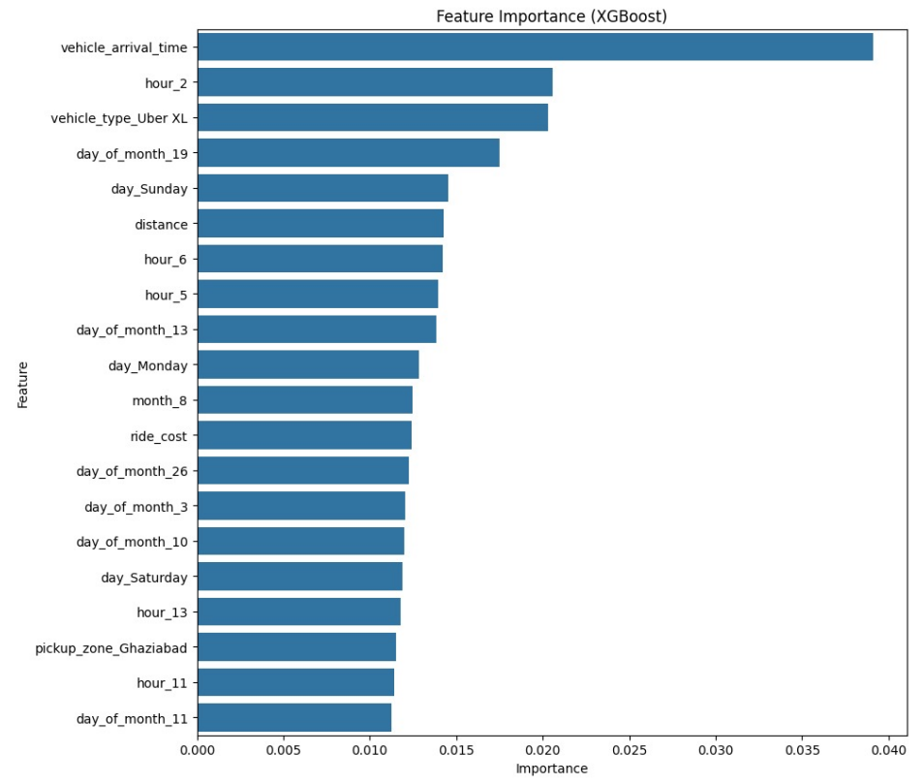
Feature Importance
Model 5: Stratified K-Fold XGBoost (No SMOTE)

Slide 17
Final Model Performance Results

Slide 18
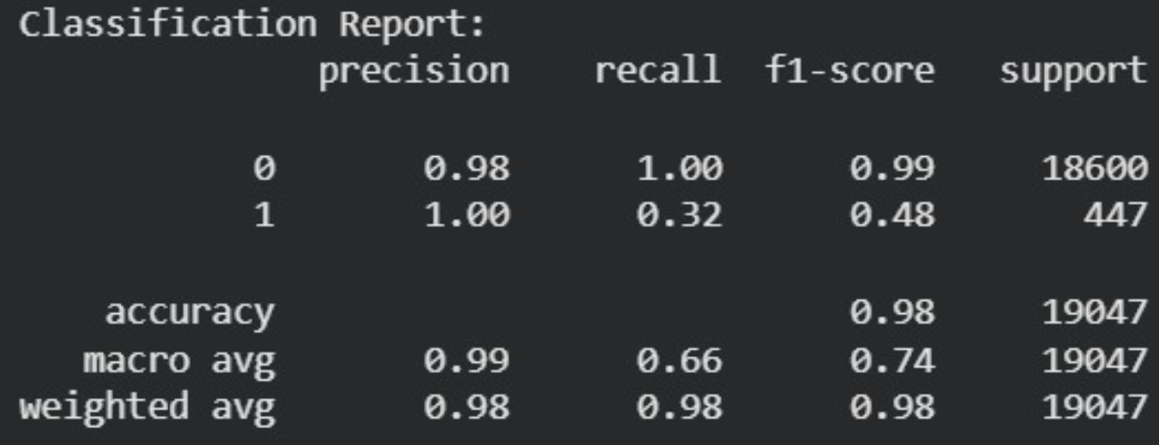
Performance Metrics
Classification Report

Slide 19
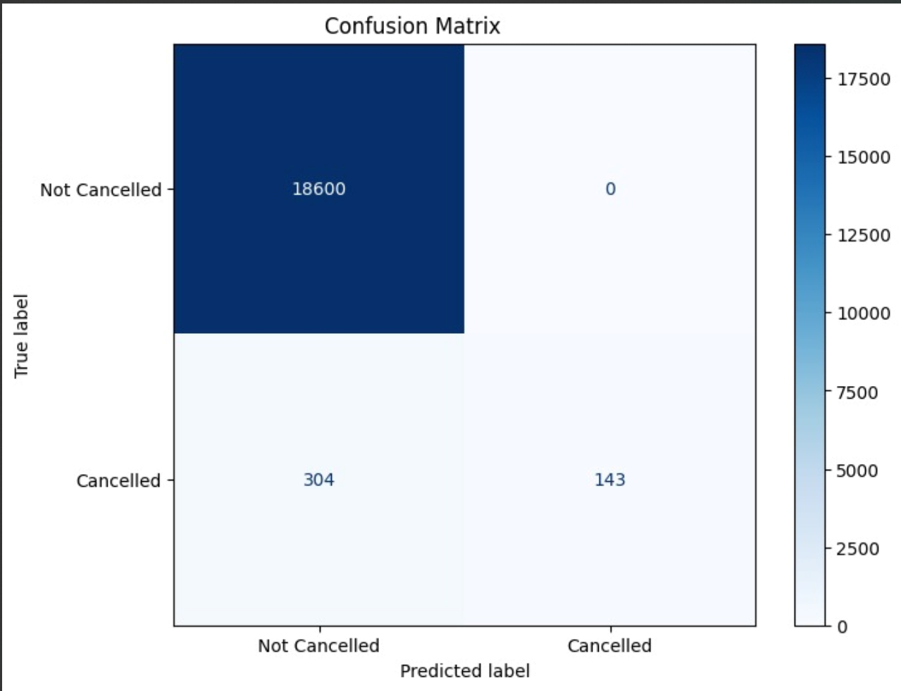
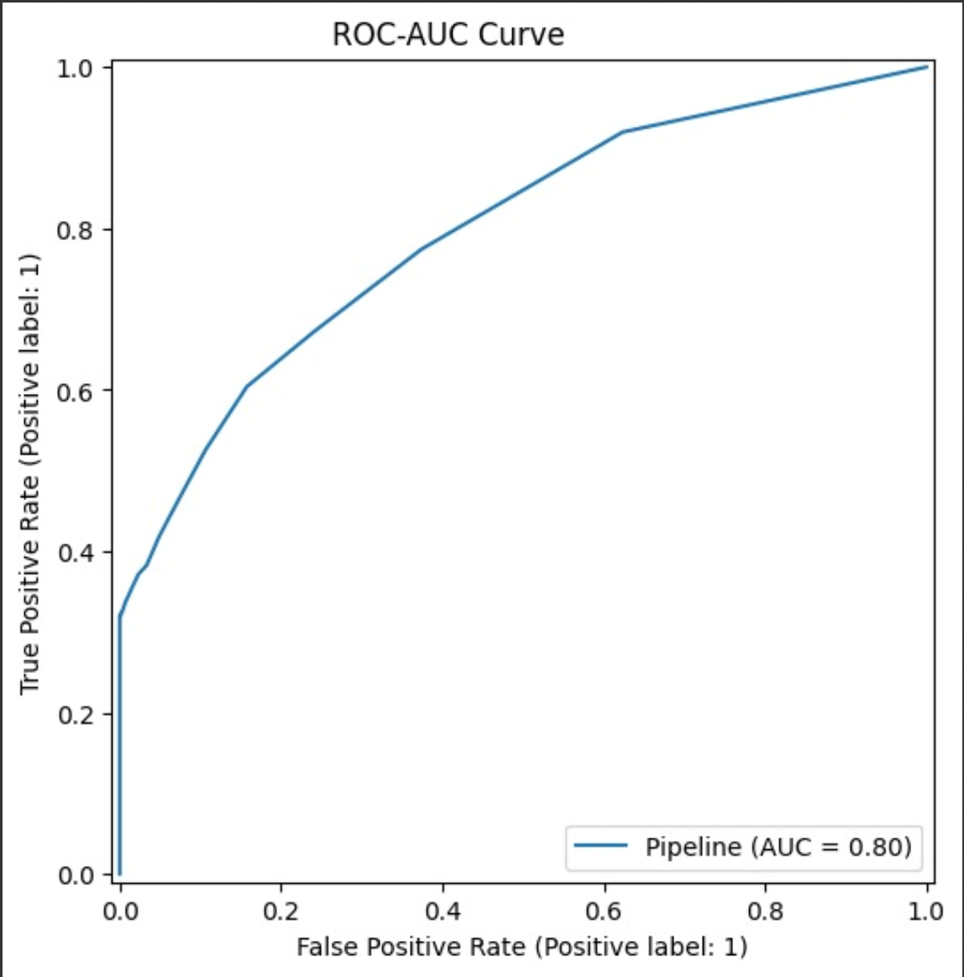
Performance Metrics
Confusion matrix
ROC-AUC Curve

Slide 20
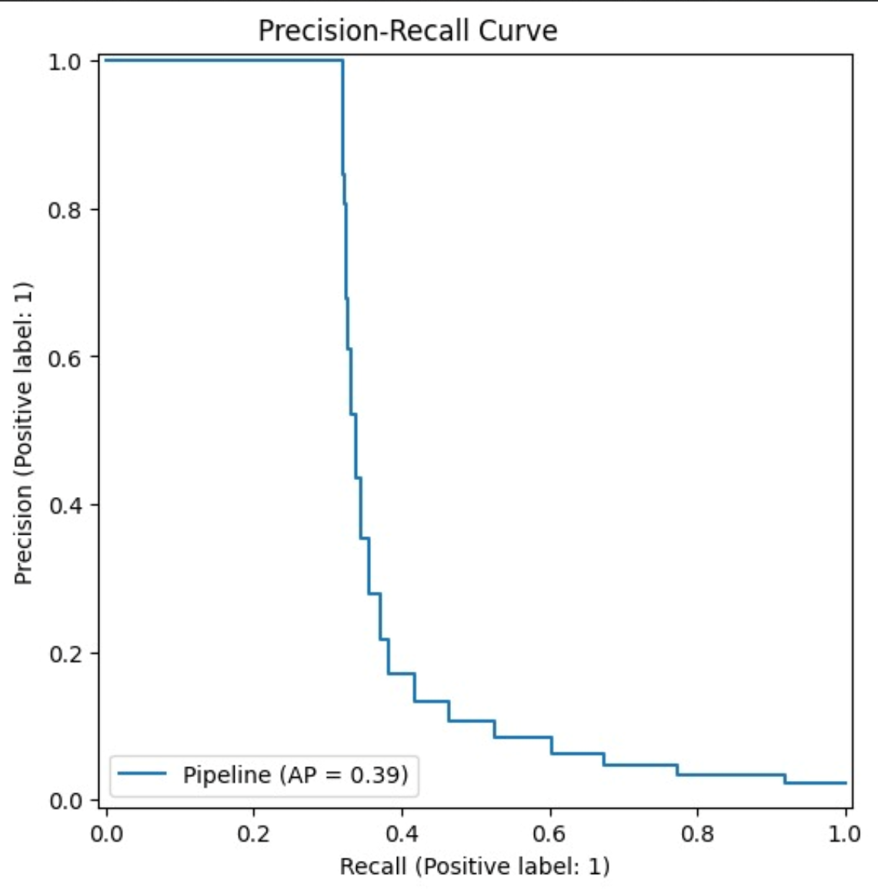
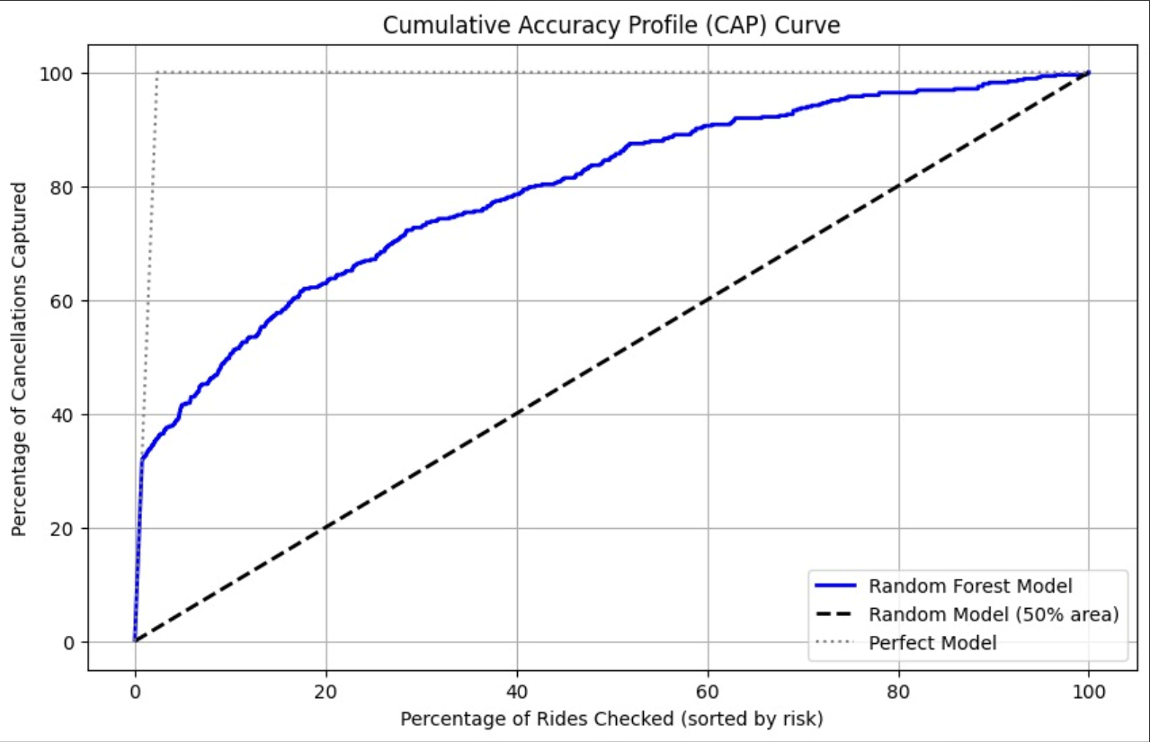
Performance Metrics
Precision-Recall Curve
CAP Curve

Slide 21
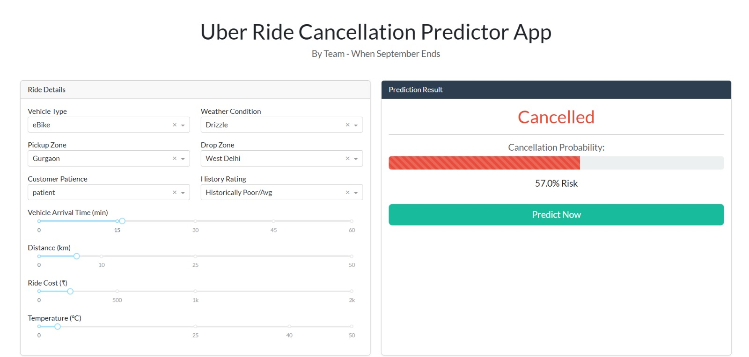
Model Deployment
After the successful training of our model, we adopted a micro-service architecture where the machine learning model is decoupled from the training environment and served via a lightweight web application.

Slide 22
Comparison With Others’ Work

Slide 23
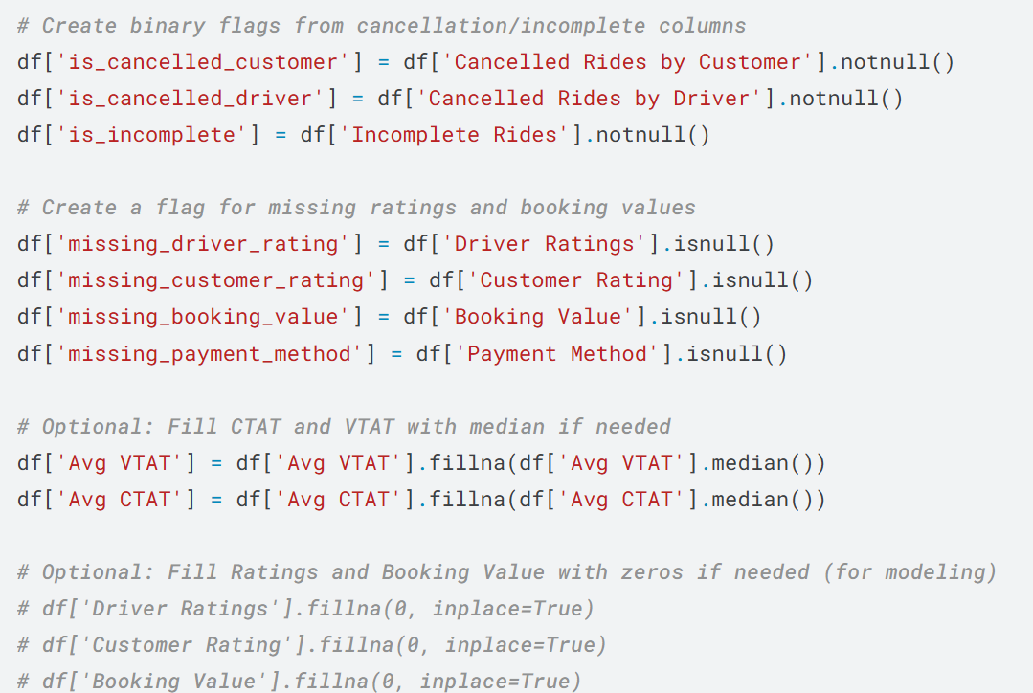
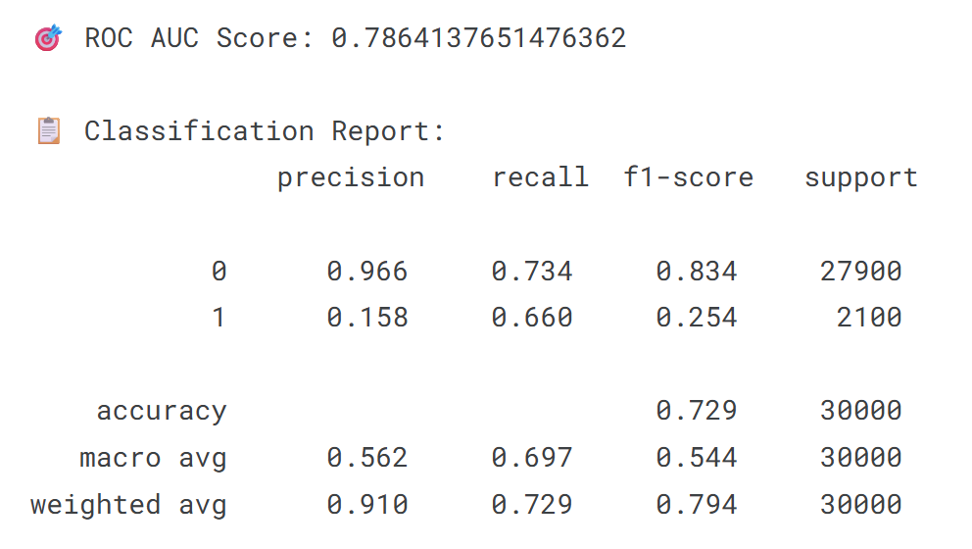
Predicting Uber Ride Cancellations -
Url: https://www.kaggle.com/code/denvermagtibay/predicting-uber-ride-cancellations
Logistic Regression Model

Slide 24
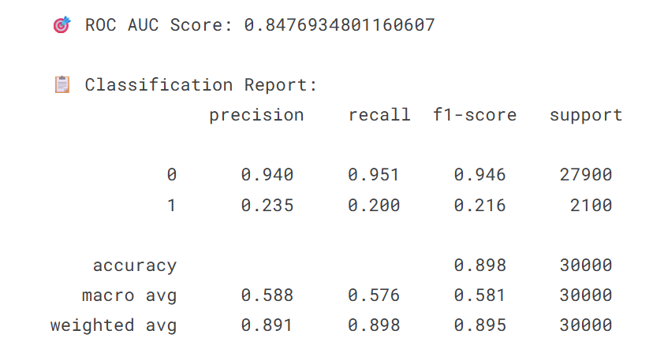
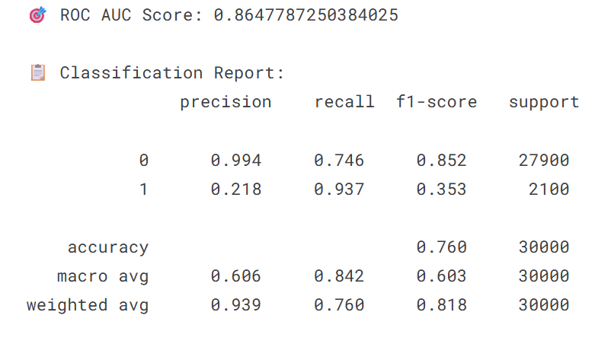
Predicting Uber Ride Cancellations - By Denver Magtibay
Random Forest Model
XGBoost Model

Slide 25
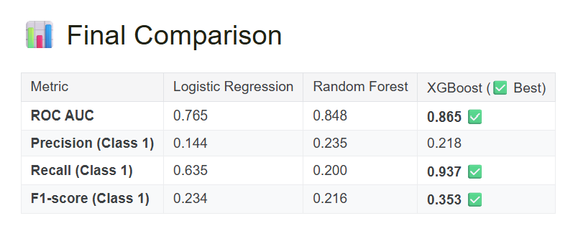
Predicting Uber Ride Cancellations - By Denver Magtibay

Slide 26
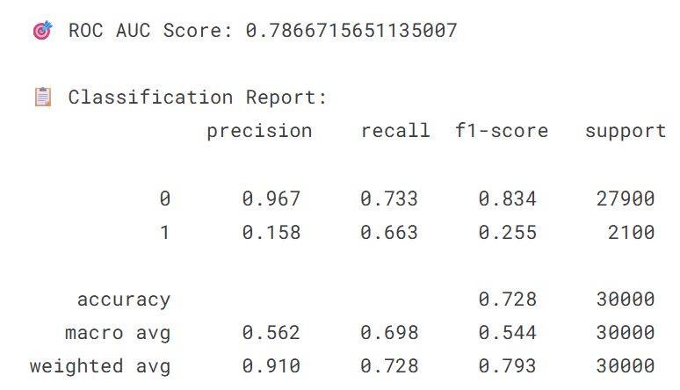
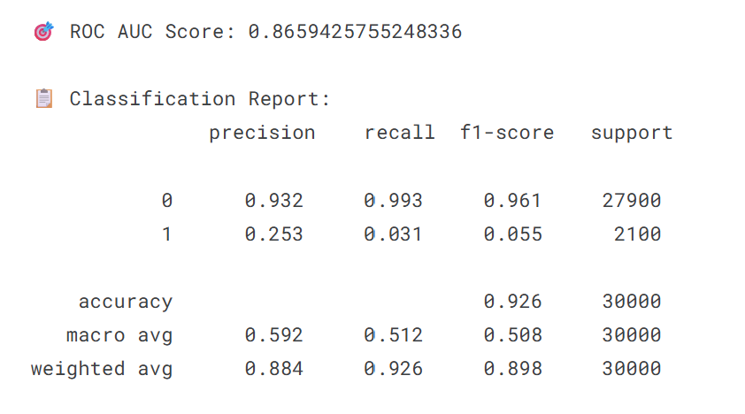
Predicting Uber Ride Cancellations - By Hùng Nguyễn Huy
Url: https://www.kaggle.com/code/hngnguynhuy/booking-cancellation-prediction
Logistic Regression Model
Random Forest Model

Slide 27
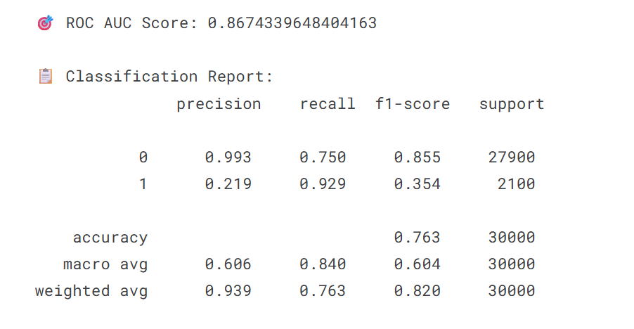
Predicting Uber Ride Cancellations - By Hùng Nguyễn Huy
XGBoost Model

Slide 28
Discussion
&
Conclusion

Slide 29
Methodology and Model Robustness
The project employed a robust Machine Learning pipeline approach to predict ride cancellations. This methodology ensures that the data preparation steps including scaling numerical features and one-hot encoding categorical features are performed solely on the training data, preventing data leakage into the test set.

Slide 30
Conclusion
The project successfully achieved its objective of developing a robust Machine Learning framework to predict Uber ride cancellations, providing a powerful tool for proactive operational intervention.

Slide 31
Thank you

